Slide 1
GOING NATIVE – A NON-DEV’S TALE
Evgenij Smirnov
Notes:
[REQUIRED SLIDE]

Slide 2
Notes:
[REQUIRED SLIDE]

Slide 3
Agenda
At the outer limits of PowerShell – as a #NotADev
Using .NET code in PowerShell scripts
Tapping into the power of unmanaged code
Wrap-up

Slide 4
AT THE FRINGES OF POWERSHELL
Reasons that provoke attempts to break out of PowerShell:
Functionality (trusty DOS commands like reg load, certutil , qwinsta and several others have no PowerShell implementation)
Functionality (PowerShell methods sometimes have limitations → I’m looking at you, Set-ACL)
Interoperability (an application may have an API but not a native PowerShell module)
Performance (see my other PSConfEU 2020 talk for more on that)
Most of this stuff will probably appear trivial… to a Dev ☺

Slide 5
BREAKING OUT OF POWERSHELL
There are three major challenges in breaking out of PowerShell:
Figuring out how to embed and execute the lower level code
Figuring out how to pass parameter values and retrieve results
Handling errors (because these will happen!)
In this session, I will briefly cover my journey to
.NET code
Native (unmanaged) code
from a purely non-developer perspective.

Slide 6

.NET CODE: INCEPTION, LEVEL 1

Slide 7
ACCIDENTAL .NET in POWERSHELL
# We use .NET in PowerShell every day:
# static properties (constants) and methods: $Ceiling = [int]::MaxValue [string]::IsNullOrWhiteSpace($Argument)
# object types that perform better than PowerShell (in some way)
$better_array = New-Object System.Collections.ArrayList
$adsi = New-Object System.DirectoryServices.DirectorySearcher
# Dot Notation for methods, the “pure blood PS” way is a cmdlet…
$padded_string = $var.PadLeft(10, "-")

Slide 8
INTENTIONAL .NET IN POWERSHELL
In explicit embedding .NET objects and namespaces into your PowerShell scripts, you do exactly the same:
Invoke static methods (functions)
Access static properties (constants)
Instantiate objects from types (classes)
Access objects’ properties (read / write)
Invoke objects’ methods
The only thing to keep in mind is: You always need a class to start from!

Slide 9
EMBEDDING .NET (C#) CODE
You found some really cool C# code but can’t or won’t translate it to PowerShell? (hint: if unsigned integers play an important role there, you shouldn’t even try ;-) )
Just make sure it’s wrapped in a class and then
Add-Type
that class to your PowerShell code.
You can embed multiple classes in a namespace to keep track of your custom definitions or just add a single function

Slide 10
A very simple .NET class

Slide 11
Keeping .NET classes together

Slide 12
Adding a single method

Slide 13
EMBEDDING .NET (C#) CODE – GOOD TO KNOW
Important: If you add a type definition to your PowerShell session (‘App Domain’ is what happens underneath in .NET), you can’t un-add or overwrite it!
This is something to keep in mind if you dot-source scripts.
BTW: Embedding C# classes works on PowerShell < 5!

Slide 14
COMPILED .NET CODE: ASSEMBLIES
As we saw earlier, there is a DLL at the bottom of Add-Type’d code. So if we have a .NET DLL (‘Assembly’ is the word), we can Add-Type or load it into our PowerShell.
Quite unlike the Pseudo-DLLs from the first example, you can load one and the same DLL multiple times without anything much happening.

Slide 15
Accidental databasing: SQLite

Slide 16
PREINSTALLED ASSEMBLIES
For assemblies, that have been installed (‘registered in the Global Assembly Cache, or GAC’) we don’t have to specify the physical path to the DLL. Instead, we make use of the registered name:
[Reflection.Assembly]::LoadWithPartialName('System.Drawing')
# You will still find this in many code snippets on the Internet. # However, explicit partial name loading has been deprecated # so you either use the fully qualified name or fall back # to Add-Type with –AssemblyName or –Path argument: $an="System.Drawing, Version=4.0.0.0, Culture=neutral, PublicKeyToken=b03f5f7f11d50a3a"
Add-Type –AssemblyName $an
[Reflection.Assembly]::Load ($an)

Slide 17
PREINSTALLED ASSEMBLIES – CONT’D
Finding the fully qualified names of registered assemblies:
GACUTIL.EXE /L (Visual Studio)
or by reading the registry (HKEY_CLASSES_ROOT\Installer\Assemblies\Global):
New-PSDrive -Name HKCR -PSProvider 'Microsoft.PowerShell.Core\Registry’ -Root HKEY_CLASSES_ROOT
Get-ItemProperty -Path 'HKCR:\Installer\Assemblies\Global’ | Get-Member -MemberType NoteProperty

Slide 18
PASSING DATA BACK AND FORTH
PowerShell functions usually accept arguments by their value. The [ref] type is possible in PowerShell, but not very widely used.
In native .NET, [ref] is much more widely used. Additionally, there are [in] and [out] decorators that both require [ref] variables.

Slide 19
Passing parameters to .NET functions

Slide 20
HANDLING ERRORS
PowerShell has the concept of terminating and non-terminating errors. C# lacks this distinction, exceptions are always terminating and need to be handled.
In calling .NET methods from PowerShell, the behaviour 99% of the time is thus:
If you don’t try/catch the method invocation, exceptions thrown by the method are non-terminating as far as PowerShell is concerned
If you put the method invocation into a try clause, all exceptions are caught and processed as terminating errors

Slide 21
Raising and handling errors

Slide 22

NATIVE CODE: InCEPTION, LEVEL2

Slide 23
ACCESSING UNMANAGED CODE – the basics
If you see some cool urgently needed functionality in a DOS program…
…that doesn’t seem to exist in PowerShell…
…or .NET…
…you have the choice:
call the DOS tool from within your PowerShell script
PowerShell can help a lot in composing complex parameters
but parsing the output is a PITA, and so is error handling
or see what APIs the tool is using and call them yourself

Slide 24
ACCESSING UNMANAGED CODE – the basics
There is NOT a “PowerShell way” to interact with native code.
.NET, on the other hand, can interact with functions (‘entry points’) exported from native code DLLs. This is part of what’s called ‘Interop’.
This is why you have to dive through two levels of inception to get your PowerShell code to interact with native code:
first, embed a call to a native DLL function into .NET
then, invoke that .NET from PowerShell
@mattifestation did a very nice 3-part writeup on this on the Scripting Guys’ blog back in 2013: https://devblogs.microsoft.com/scripting/use-powershell-to-interact-with-the-windows-api-part-1/

Slide 25
ACCESSING UNMANAGED CODE – the basics
Usually, embedding a Win32 API function into your PowerShell code is a three-step process:
Find the native function definition (in the vendor’s documentation, i.e. https://docs.microsoft.com/de-de/windows/win32/api/ for Windows built-in stuff)
Find a P/Invoke definition of that call (http://pinvoke.net/ is a good starting point for the built-in stuff)
Then Add-Type the appropriate method definition to your PowerShell code and call the method.
Easy, right?

Slide 26

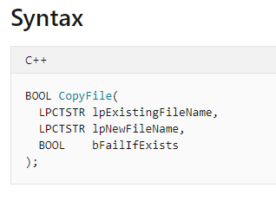
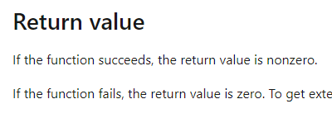
ACCESSING UNMANAGED CODE – the basics
As a non-developer, a tremendous amount of WTF? is involved in this process.
First, the native definition is just weird:
https://docs.microsoft.com/de-de/windows/win32/api/winbase/nf-winbase-copyfile
…and then it says (for a boolean)…

Slide 27
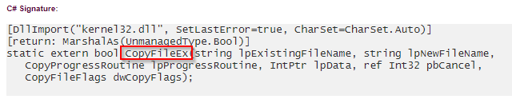
ACCESSING UNMANAGED CODE – the basics
P/Invoke doesn‘t make it any clearer:
http://pinvoke.net/default.aspx/kernel32/CopyFile.html
actually references CopyFileEx, with slightly different parameters:
Luckily for us, Matt’s demo still works.
Let’s look at it and learn an important lesson.

Slide 28
Naming P/Invoke calls

Slide 29
IF NAMES DON‘T ACTUALLY MATTER, then what does?
This is the single most important thing to wrap our non-developer heads around: how unmanaged code handles function arguments.
PowerShell functions bind arguments by name or position and go out of their way trying to convert the type if the type of the receiving parameter has been specified. Otherwise, the type conversion is attempted within the function.
.NET (C#) functions bind arguments by position and the type has to match (with very few exceptions).
Native functions, on the other hand…

Slide 30
Just dump it here, will ya?
Native functions do not really bind at invocation. What actually happens is (simplified for non-devs) this:
Arguments are all of fixed length types (mostly variations of integer or float) → the entire memory demand of all arguments is fixed
The caller must supply the exact amount of memory bytes the function expects to receive (i.e. if the function takes 2x [uint32], you can supply 1x [uint64])
The function will treat each part of the memory chunk supplied by the caller according to its internal definition.
That’s ‘unmanaged’ for you ☺

Slide 31
string is where the trouble begins
Since strings, array, objects etc. are usually of variable length, a pointer to where they‘re stored in memory is used to pass it as an argument to a function (thus lpExistingFileName).
The process of converting an object of a .NET type to a pointer to that object (and back) is called marshaling. It happens implicitly in simple scenarios (like our CopyFile) but can be enforced by adding the [MarshalAs(<type>)] decorator to the P/Invoke.
More on marshaling: https://docs.microsoft.com/en-us/dotnet/standard/native-interop/type-marshaling

Slide 32
Putting it all together

Slide 33
Summary
Knowing how native code handles memory is important if you’re stuck.
Watch out for strings – they’re trouble and may require StringBuilder and additional marshaling to be received correctly from a function.
Read up on data structures – they are used widely throughout the native API landscape!
Start thinking in modules early, especially when accessing unmanaged code!
Keep a working Visual Studio handy. Community Edition is enough if you are #NotADev.

Slide 34
Notes:
[REQUIRED SLIDE]

Slide 35


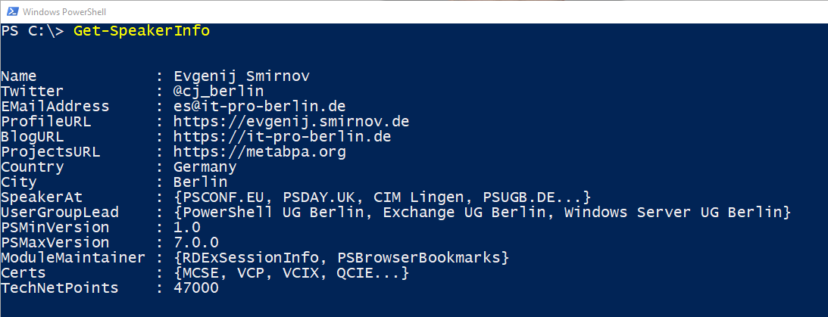
about_Speaker
Notes:
[REQUIRED SLIDE]

Slide 36

Delegate sign-up opens November 2020 at https://psconf.eu
Notes:
[REQUIRED SLIDE]

